Slide 8
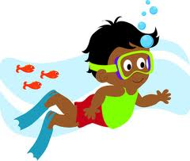
Topic: Learn to swim.
Reason: Safety
Explain: Help yourself
Explain: Help others
Reason: Good Exercise
Explain: Aerobic activity
Reason: Social/Enjoyment
Explain: Summer parties
Explain: Vacation
Conclusion: Benefits of being a great swimmer

Slide 9
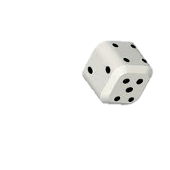
Roll for a topic:
1. If I were principal for a day…
2. Start of a new school year…
3. If I had $100…
4. Favorite food to eat…
5. Favorite person…
6. Dream vacation…

