Slide 1
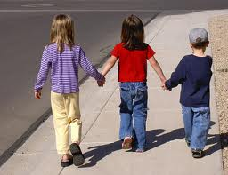
Able to find solutions during conflicts with others
Demonstrates respect for feelings of others
Knows when and how to include

Slide 2
What would you do?
Tom had a ball at recess. As Jim threw him the ball he missed catching it and it rolled behind him. As Tom went to get the ball another boy had picked it up and started shooting hoops with it.

Slide 3
What would you do?
Suzy just found out she was going on vacation to Disney Land. She was so excited, and told her friend, Marie, about the trip. This was Marie’s response, “I’ve already been there. My family went for a whole week. I bought 20 pins, and rode all the rides 3 times. I’m going this summer, too!”

Slide 4
What would you do?
John started a Thursday Club. He had the idea to make a Suduko Club. His dad had just taught him how to do Suduko and he liked the challenge. He posted a sign up list outside his classroom. No-one signed up to be in his club.

