Slide 1
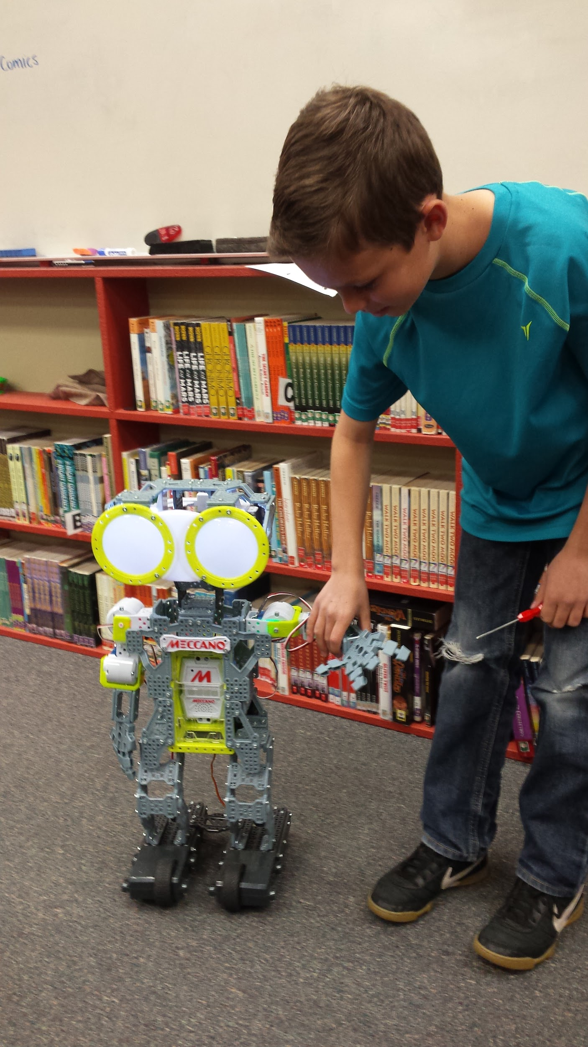
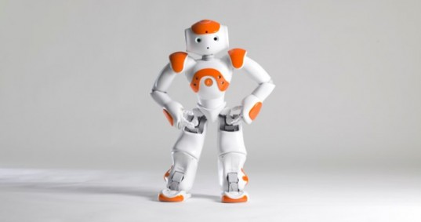
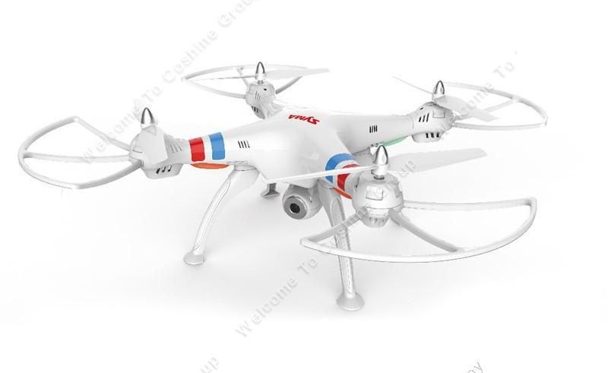
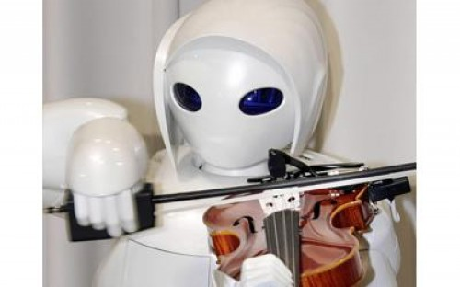
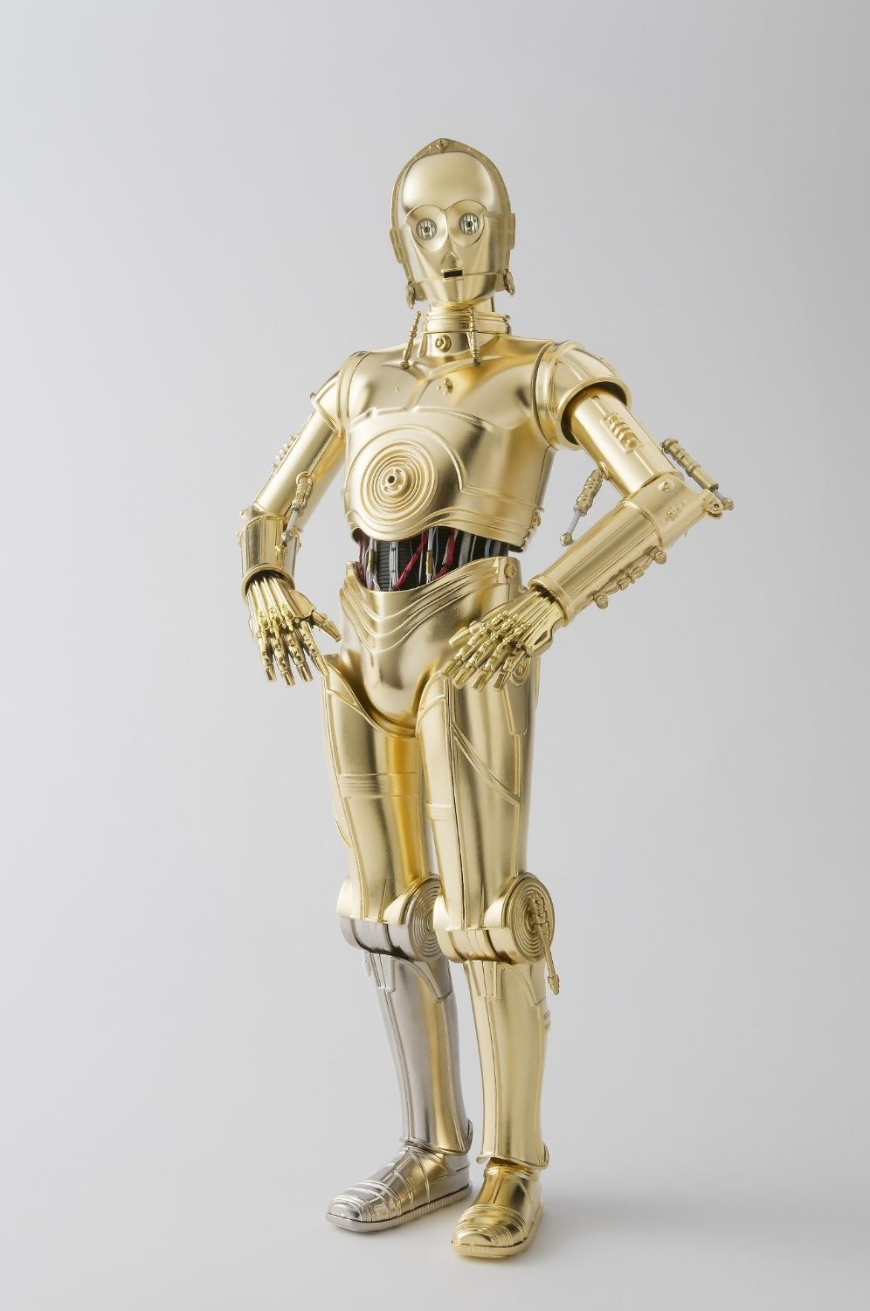
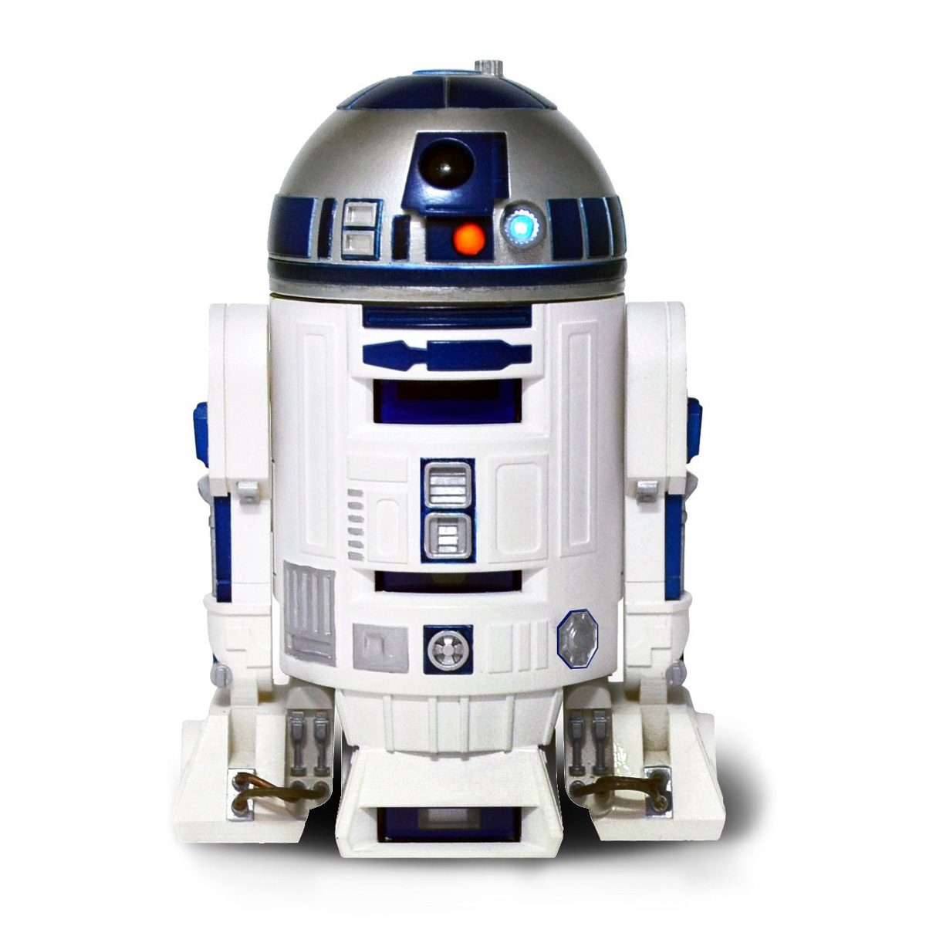
Robotics
By: Sam
P.S. look for a smiley face on each slide.

Slide 2
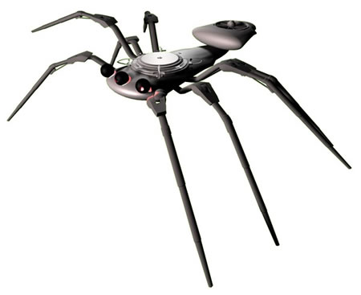
Why they are made and why they are here.
Many robots are made for different reasons. They are made for entertainment, helping in communities, helping in wars, helping in natural disasters, doing discoveries, and building.

Slide 3
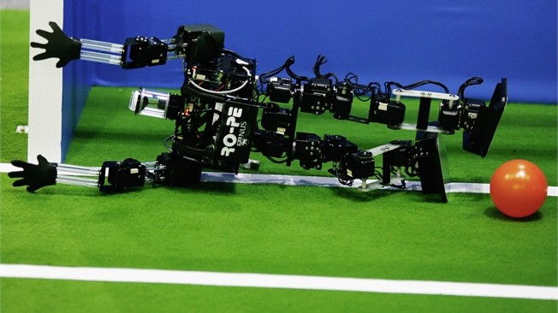
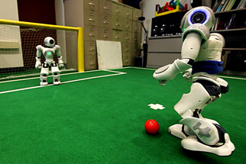
Entertainment
Many robots play for entertainment. For example, some of these things they do to entertain people is play sports such as soccer, to play with children, and sometimes dance.

Slide 4
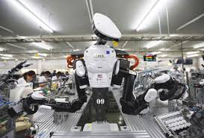
Jobs and Communities
Sometimes factories don’t have enough people so they have robots help with the job. They can also help in communities by taking care of the elderly and getting medicine for the doctors in the hospitals if the doctors can’t leave the patient. The robots can help the elderly by pushing their wheelchairs and bring the elderly stuff they need.

Slide 5
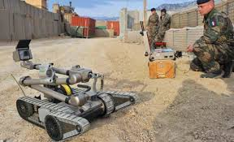
Wars
In wars robots are used to deactivate bombs and the army would rather lose a robot than rather losing a human. They can also be used to spy on the enemy gather important information.

Slide 6
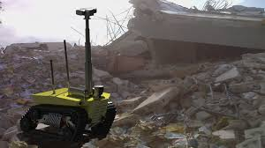
Natural Disasters
Robots are useful in natural disasters. They can get in angles we humans can’t because it would be too risky. Robots can also get in small spaces to check on people. Another thing they can do is check a structure such as a bridge to make sure they are stable.

Slide 7
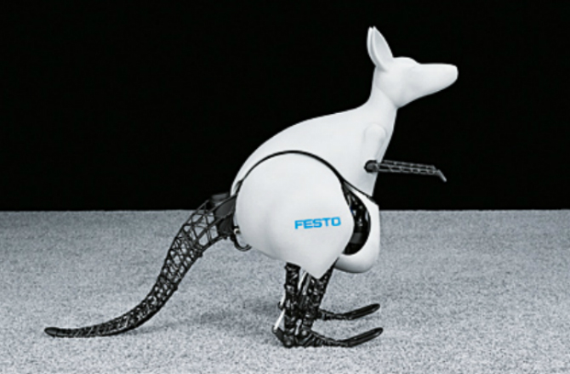
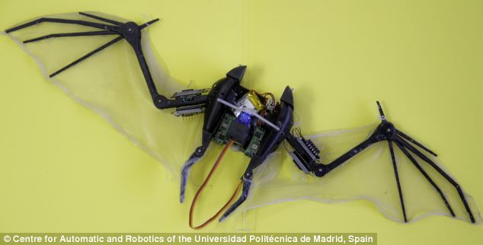
Animals
Sometimes, scientists make robots like animals to understand them more. They are fun to look at.

Slide 8
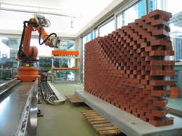
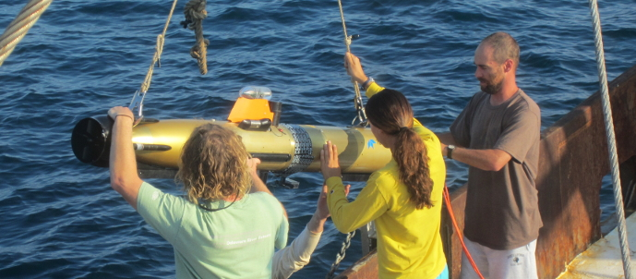
Discoveries and Constructing
Robots can go underwater to find old ships and treasure. When robots build, they scan the blueprint, gets the cargo, and safely constructs the building.

Slide 9
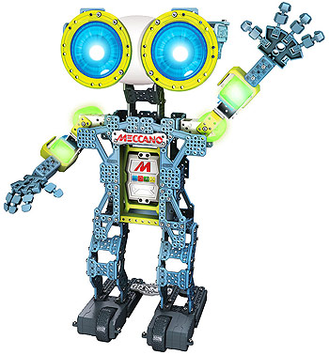
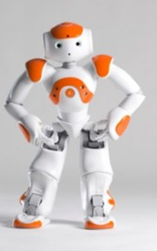
The End
Bye-Bye human friends! See you soon! I’m coming to get you.

