Slide 1
Flight
By Ayden cox

Slide 2
Question ????
What paper airplanes fly longest
Also fastest
Why I always liked planes
I like the idea of flight

Slide 3
Product
Paper plane contest
12 planes competing for fastest and farthest

Slide 4
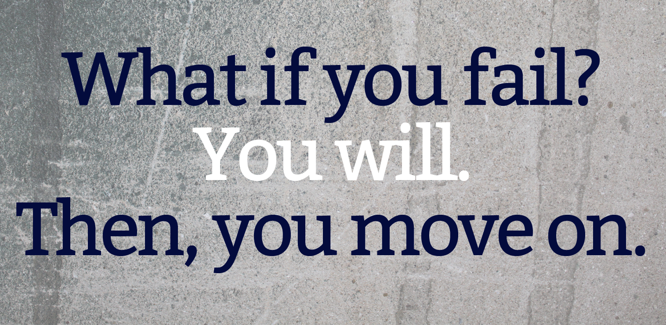
Problems
Epic failure 1
To much $$$$$$
Rc airplane $150
Paper airplanes sometimes dud

Slide 5
Learning wins
New designs
12 cool planes
Knowledge of origami folding

Slide 6
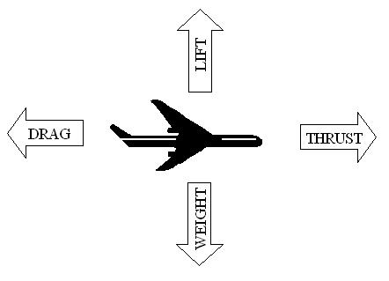
Forces of flight and body of planes
fuselage
Fuselage = the body
Wings = lift and weight
Engines = thrust conquers Weight
Elevator =up down
Rudder =left right
Cockpit = control central
wings
Cockpit
rudder
engine

Slide 7
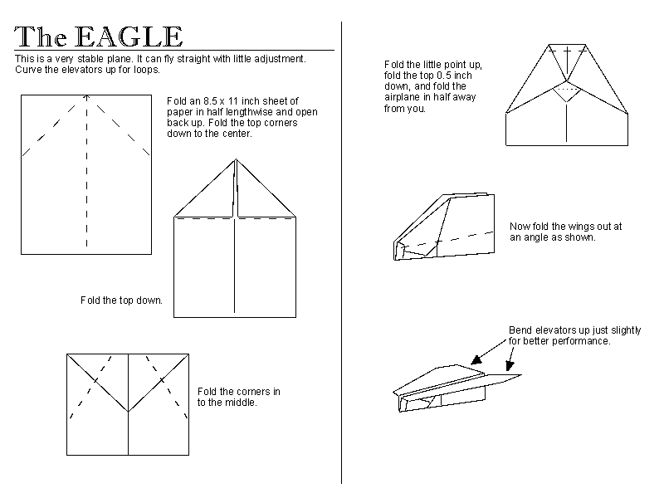
The eagle
Very simple
Good flyer
Easy to make
Cool name

Slide 8
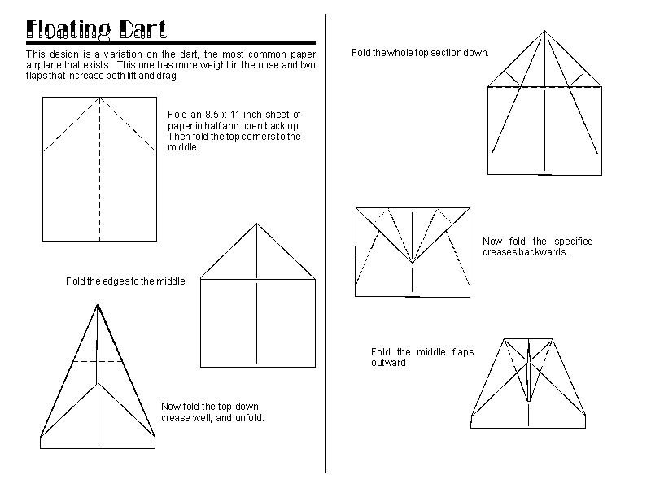
the dart
Easy to make
Fly far and fast
Most people prefer
Another cool name

Slide 9
Glider
Very simple
Last long
Easy to make
Sort of cool name

