Slide 1
Kinds of Sentences
Lesson 3

Slide 2
A sentence that ends in a question mark is called an…
interrogative

Slide 3
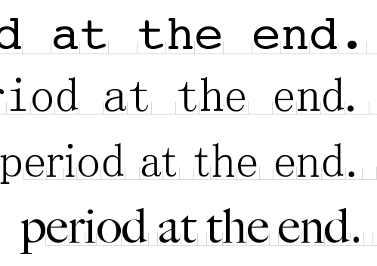
A declarative sentence ends with a …
period.

Slide 4
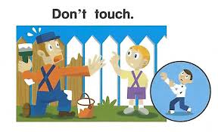
imperative
This is an example of what kind of sentence?
An imperative sentence is a command.

Slide 5
What kind of
sentence is this?
Exclamatory!

Slide 6
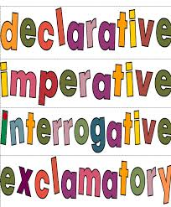
Make a “flip book” with four tabs.
Each tab will have one of these four words on top.
Under each tab, give an example of the punctuation.
. or ?or !
Under each tab write a sentence example .
command
exclamation
statement
question
statement
command
question
exclamation

