Slide 1
My journey in genius hour Genius Hour
By: Jack P.

Slide 2
My Driving Question
My driving question was; ”How can I learn about US wars and make a website about them?

Slide 3
Why?
I wanted to learn about US wars because it may be useful in later life because I might want to be a historian when I grow up.

Slide 4
How?
I planned to make a website about some wars in the US. Then I could share my knowledge with other people.

Slide 5
Success
Success to me would look like a fully developed website where people could learn about US wars, but as some of you know…

Slide 6
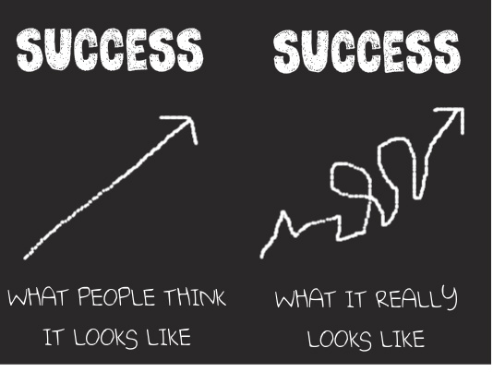
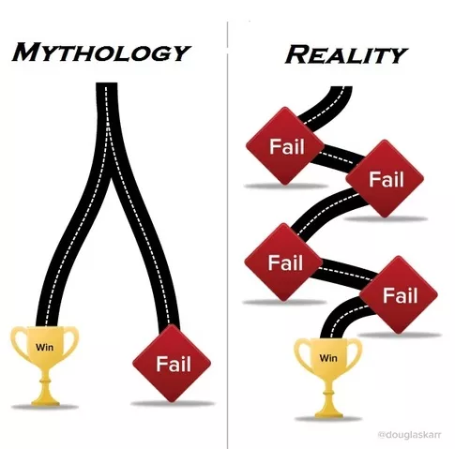
I Failed…
I wish I had finished all my websites pages, but I just didn’t have time. If you want to view my website, click here.

Slide 7
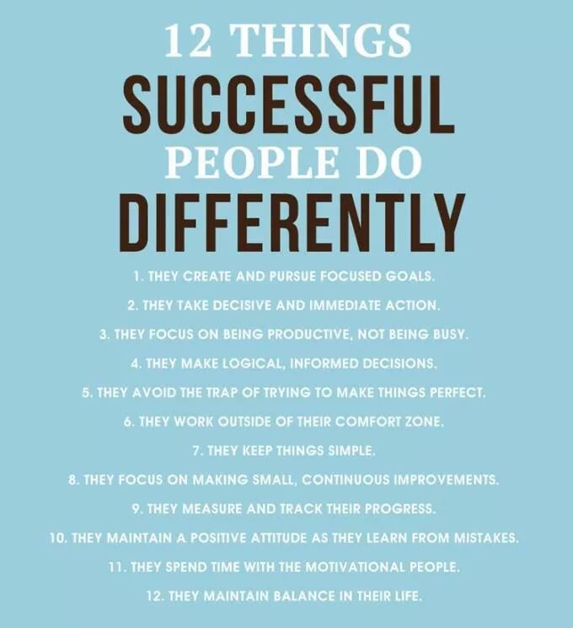
However
During the summer, I plan to continue working on my website. I don’t know if I’ll finish, but I sure hope I do.

