Slide 1
Cartooning
By: Joshua

Slide 2
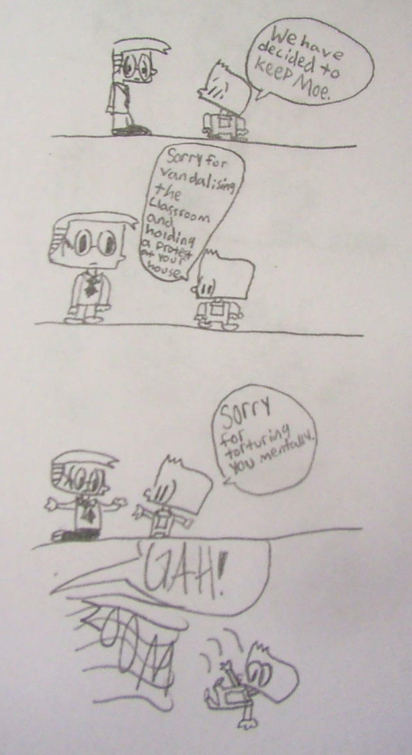
STRUGGLES
THESE ARE SOME OF THE STRUGGLES I HAD.
1. I wanted to start so badly I rushed into the project and it was like in 2000 ft. water, I drowned.
2. Since I rushed into to my project , I didn’t chart any of my steps, and so I had to restart my WHOLE project.
3. When I restarted my project, I thought I would only have to do one thing, I was wrong. I had to make a golden age comic timeline (which I will share in a minute.) And I had to get more information on comic artists. (Which I will share with you in the next slides.)
4.When I did try to get more info, my hand cramped A LOT!

Slide 3
LEARNING WINS
1. I learned about the subject I love
2. I get to share this PowerPoint with all of you guys!
3. I’ve accomplished something I never thought I would ever accomplish.
4. I got the chance to make my own comic! (the name I will share with you at the end.)
HERE ARE SOME

Slide 4
Lincoln Peirce creator of Big Nate (52 years old right now.)
Some interesting things about him are:
Started Big Nate in 1991
Likes elves and dwarfs
First Big Nate comic book he ever made was: Draw more babes.
His favorite gag on Big Nate was ACTION CAT!, but all the cat did was get hit by cars, so he was forced to remove it.
Never has won any rewards for his work ☹
Something no one knows about him is… One more hole punch in his Jiffy Lube punch card and he has a free oil change!

Slide 5
Bill Waterson creator of Calvin and Hobbes (at age 57 right now.)
Created Calvin and Hobbes in 1985
Calvin and Hobbes was created… before it was created.
Bill stayed out of trouble, unlike his creation, Calvin.
Believe it or not, but his cartoon ideas were rejected for 5 whole years!
He was the youngest person to win the NCSRA- the biggest honor to a cartoonist. (NCSRA stands for National Cartoonists Society's Reuben Award.)

Slide 6
Jim Davis creator of Garfield (at age 70 right now)
Started Garfield in 1978
Jim has won 4 Emmy Awards
Likes gardening, fishing, and spending time with his family.
He wasn’t born a cartoonist! He had to label everything, “my drawings were terrible!” he exclaims
His first comic strip, Gnorm Gnat, was a complete flop! The Syndicate said “bugs?” and, “who can relate to bugs!” so Jim ended the strip by having Gnorm Gnat say “Is that a shoe!?” then the next panel being darkness.
Charles M. Schulz gave Jim the idea of having Garfield stand on two feet instead of four, like he’d done with Snoopy.

Slide 7
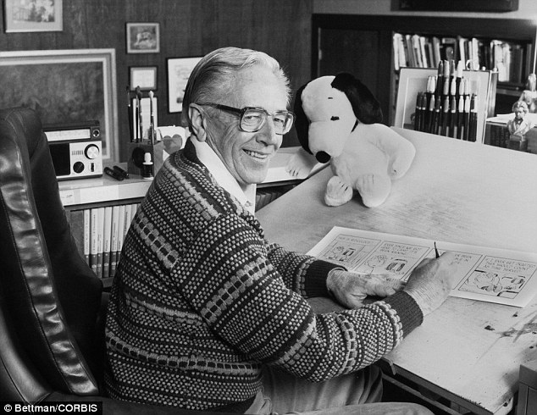
Charles M. Schulz creator of Peanuts (age: dead right now)
Created Peanuts in 1950
Charles’s first dog, Snooky, inspired the idea of Snoopy
The Great depression did not affect his family, or so he said
You know the little red- haired girl? I don’t! I know Donna Mae Johnson, Schulz’s sweetheart through college, who broke his heart (see a “Charlie Brown new year”)
At age 20, Schulz was drafted to the U.S. Army for WW2, as many other men of his generation.
Schulz HATED the name “Peanuts” for his comic strip, he wanted the name to be “Li’l Folks” like his 2nd comic strip, but it sounded too much like “Li’l Abner” and he soon discovered that he couldn’t use the name “Li’l Folks” again.

Slide 8
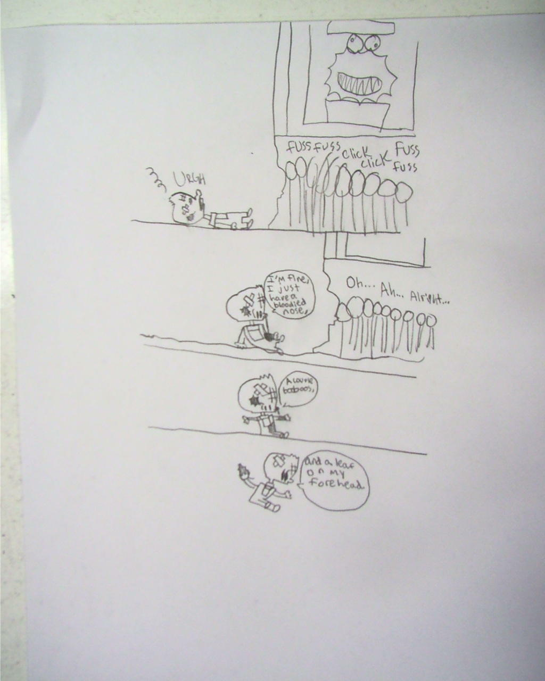
THE END!
Oh, and by the way, my comics name is Preschool comics

