Slide 1
Form in Poetry
Helpful guidelines from
Jim Richards
BYU-Idaho

Slide 2
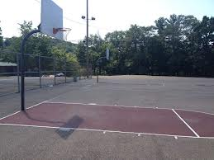
18 inches
10 feet
15 feet

Slide 3
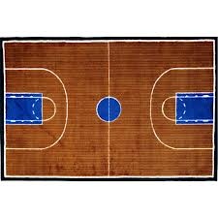
Why?
…..the CHALLENGE!
19’9”
47 feet

Slide 4
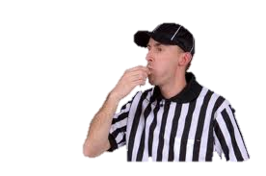
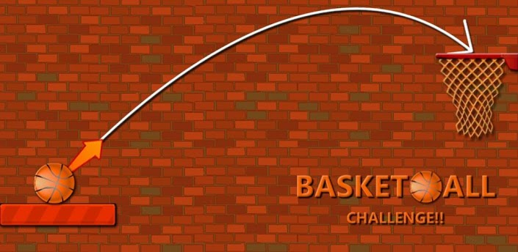
When a basketball player accepts the challenge to
play ball they must follow the rules of the game.
When a poet involves meter, rhyme, or line structure in their poetry they are taking on the challenge of FORM.

Slide 5
métĕr
Soldiers marching, “Left, left, left-right, left”
“I don’t know what I’ve been told,
Poetry is never old.”
“I don’t know but I have heard, Woody is a pecking bird.”

Slide 6
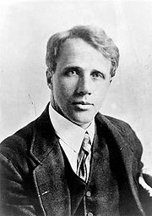
rhyme
Dust of Snow
By Robert Frost 1874–1963
The way a crow
Shook down on me
The dust of snow
From a hemlock tree
Has given my heart
A change of mood
And saved some part
Of a day I had rued.

Slide 7
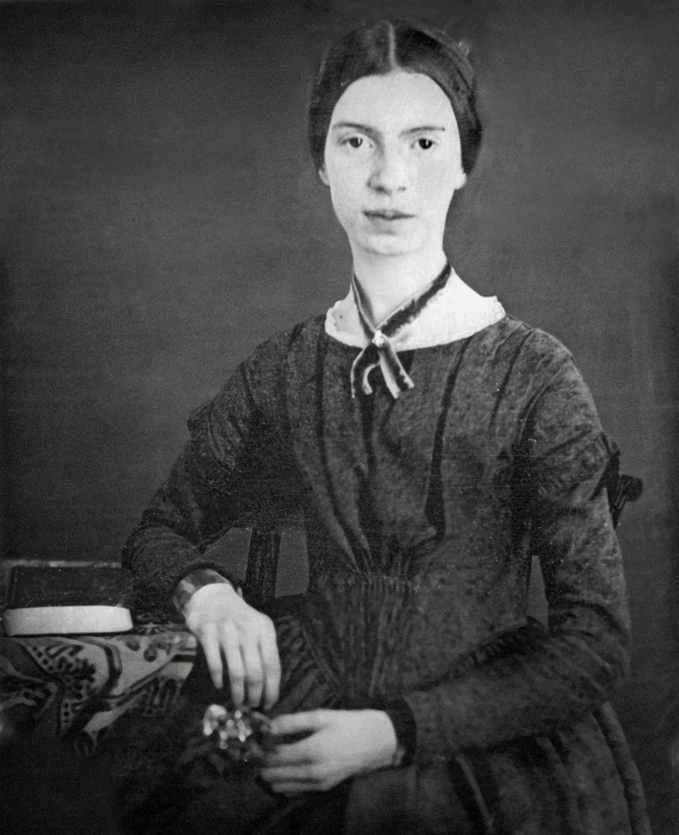
length (line structure)
“Hope” is the thing with feathers
By Emily Dickinson 1830–1886
Sign Language Video
“Hope” is the thing with feathers -
That perches in the soul -
And sings the tune without the words -
And never stops - at all -
And sweetest - in the Gale - is heard -
And sore must be the storm -
That could abash the little Bird
That kept so many warm -
I’ve heard it in the chillest land -
And on the strangest Sea -
Yet - never - in Extremity,
It asked a crumb - of me.

Slide 8
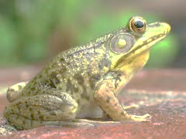
I'm Nobody! Who are you?
by Emily Dickinson
I'm Nobody! Who are you?
Are you – Nobody – too?
Then there's a pair of us!
Don't tell! they'd advertise – you know!
How dreary – to be – Somebody!
How public – like a Frog –
To tell one's name – the livelong June –
To an admiring Bog!
What do you notice about:
meter?
rhyme?
length?

Slide 9
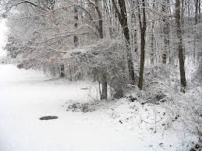
Stopping by Woods on a Snowy Evening
By Robert Frost 1874–1963
Whose woods these are I think I know.
His house is in the village though;
He will not see me stopping here
To watch his woods fill up with snow.
My little horse must think it queer
To stop without a farmhouse near
Between the woods and frozen lake
The darkest evening of the year.
He gives his harness bells a shake
To ask if there is some mistake.
The only other sound’s the sweep
Of easy wind and downy flake.
The woods are lovely, dark and deep.
But I have promises to keep,
And miles to go before I sleep,
And miles to go before I sleep.
What do you notice about:
meter?
rhyme?
length?

Slide 10
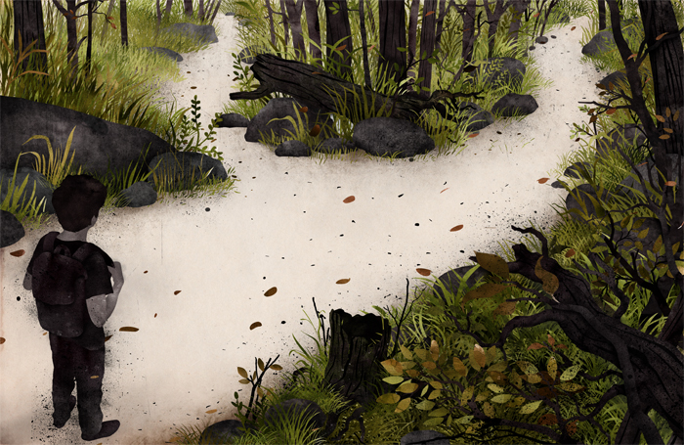
What do you notice about:
meter?
rhyme?
length?
The Road Not Taken
By Robert Frost 1874–1963
Two roads diverged in a yellow wood,
And sorry I could not travel both
And be one traveler, long I stood
And looked down one as far as I could
To where it bent in the undergrowth;
Then took the other, as just as fair,
And having perhaps the better claim,
Because it was grassy and wanted wear;
Though as for that the passing there
Had worn them really about the same,
And both that morning equally lay
In leaves no step had trodden black.
Oh, I kept the first for another day!
Yet knowing how way leads on to way,
I doubted if I should ever come back.
I shall be telling this with a sigh
Somewhere ages and ages hence:
Two roads diverged in a wood, and I—
I took the one less traveled by,
And that has made all the difference.

Slide 11
I don’t know but __________________
______ is ________________________
The way _____ shook down on me
The _____ from a _______________
I’m __________, who are you?
Are you _____________, too?
Then…
__________ is the thing with ____________
That ______________________

