Slide 1
Poetry
Is spacing important?

Slide 2
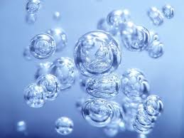
Bubbles
Floating holes reflecting spheres little rainbow heads glued together like magnets liquid
crystal balls silent
popcorn
bubbles

Slide 3
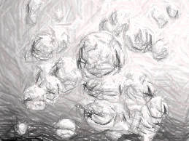
Bubbles
Floating holes
Reflecting spheres
Little rainbow heads
Glued together like magnets
Liquid crystal balls
Silent popcorn
Bubbles

Slide 4
Poetry
Elements of
Can repetition be fun and not boring in poetry?

Slide 5
Repetition is when you have a word and use it more than once.
Inside the ocean I see fish. Inside the waves I hear a splash. Inside the water I felt a fish. It seems so big, as big as a whale. It has to be, But then I see, It's a tuna fish.
By Rachel (4th grade)

Slide 6
Under
Under the clouds, Under the trees, Under the sea, I can fall asleep, and dream of moving clouds and swaying trees, and waves moving, in the seas.
By, Jake (4th grade)

Slide 7
Poetry
Simile
Definition: Simile is when you compare two nouns that are unlike, with "like" or "as."

Slide 8
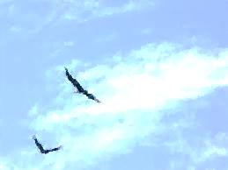
Piano
Playing the piano is like A bird soaring in the sky. When you play the keys it is like Flying your fingers across the piano. The notes are like Clouds drifting through the
sky.
By Autumn (4th grade)

Slide 9
My Mind
My mind is as brave as a warrior of the night. It's ready to take on anything that comes to it. It can take on any dream, and always follows life.
By Alex (4th grade)

Slide 10
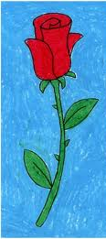
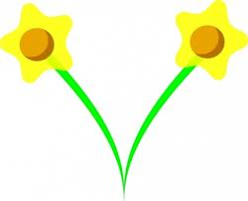
Poetry
rabbits running
over roses
dressy daffodils
Alliteration
Definition: When two or more words in a poem begin with the same letter or sound.

Slide 11
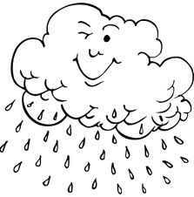
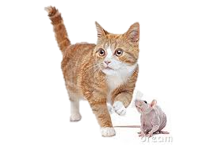
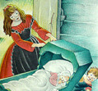
Caring Cats
Caring cats cascade off Laughing lamas Lounging. Underneath yelling yaks, Yelling at roaming Rats.
By Rebecca (4th grade)
Rain
Rain races, Ripping like wind. Its restless rage Rattles like Rocks ripping through The air.
By John (4th grade)
Daddy's Gone A Hunting
Bye, baby bunting, Daddy's gone a - hunting, Gone to get a rabbit skin To wrap baby bunting in.
By Mother Goose

Slide 12
Poetry
Example:
"Wind yells while blowing"
Personification
Definition: when you make a thing, idea, or an animal do something only humans can do.

Slide 13
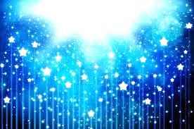
SNOW
Snow speaks to the people its falling above in the glooming sunlight. Its white sparkling voice echoes as it falls through the air.
By Jake (4th grade)
STARS Stars, bring me up with you Bring me to the place you sleep. How do you do it? Bring me to your home. Bring your thoughts to me. Share them with me. By Alex

Slide 14
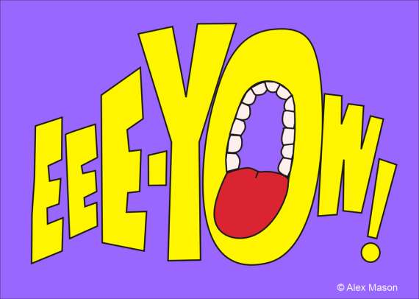
Poetry
Onomatopoeia
Example
Zip goes the jacket " Zip" is an onomatopoeia word because it sounds like a jacket is zipping up.
Boom, bang,
slash, slurp, gurgle, meow,
and woof
Definition: onomatopoeia are words that sound like the objects they name or the sounds those objects make.

Slide 15
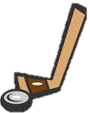
The Hockey Game
30 seconds 'til the game is over. Tick tock. Tick tock. Oh no! Slap! Bang! There goes the puck! Clink! Clank! Clink! Clank! The puck is heading for the goal! Clang! Clang! Goal! Buzz! Buzz! Buzz! Game over! Lummis wins! Rustle! Clap! Yackety Yak! We won!
The Game
Clap! Clap! Stomp! Stomp! Swish! Swish! This is the way we get through Our games. The crowd shouts, ”Yahoo!” The ball soars through the air. Then, bounce, bounce, bounce. The audience holds its breath. SWISH! The ball goes in; We win!

Slide 16
Poetry
"Dark knows daylight" is an example of paradox because dark and daylight are opposites, and yet here they have something in common.
Paradox
Definition:
A statement that seems impossible at first but actually makes sense.

Slide 17
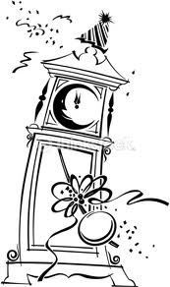
The silence of midnight,
to speak truly,
though apparently a paradox,
rung in my ears .
By Mary Shelley
Dark and Light Dark remembers light, The day they separated, They try to be friends, but can't. Dark doesn't like light Their friendship no longer exists.
By Frank (4th grade)

Slide 18
Poetry
Metaphor
Definition: Metaphor is when you use two nouns and compare or contrast them to one another. Unlike simile, you don't use "like" or "as" in the comparison.
Examples I am a rainbow
"I am a rainbow" is a example of metaphor because it is comparing two nouns, a person, and a rainbow, but does not use like or as.

Slide 19
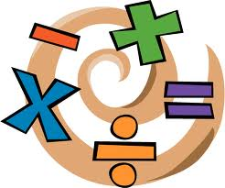
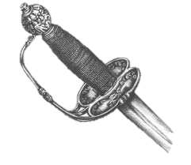
MATH
Math is the career for kids. If you don't know math you won't make any money. you won't get a job. you won't own a house.
By John (4th grade)
I AM A SWORD
I am a sword, Sharper than a tongue Nobody can defeat me, Because I am a sword, I can not be hurt by what people say About me, I will not show my anger Against Someone else.
By Brad (4th grade)

Slide 20
Repetition
Simile
Alliteration
Personification
Onomatopoeia
Paradox
Metaphor
Repetition is when you have a word and use it more than once.
Definition: Simile is when you compare two nouns that are unlike, with "like" or "as."
Definition: When two or more words in a poem begin with the same letter or sound.
Definition: when you make a thing, idea, or an animal do something only humans can do.
Definition: onomatopoeia are words that sound like the objects they name or the sounds those objects make.
Definition: A statement that seems impossible at first but actually makes sense.
Definition: Metaphor is when you use two nouns and compare or contrast them to one another. Unlike simile, you don't use "like" or "as" in the comparison.
http://library.thinkquest.org/J0112392/

