Slide 1
Buying Boards
How much is enough?

Slide 2
My daughter and her husband bought a house. They wanted to add their own design to some of the rooms.

Slide 3
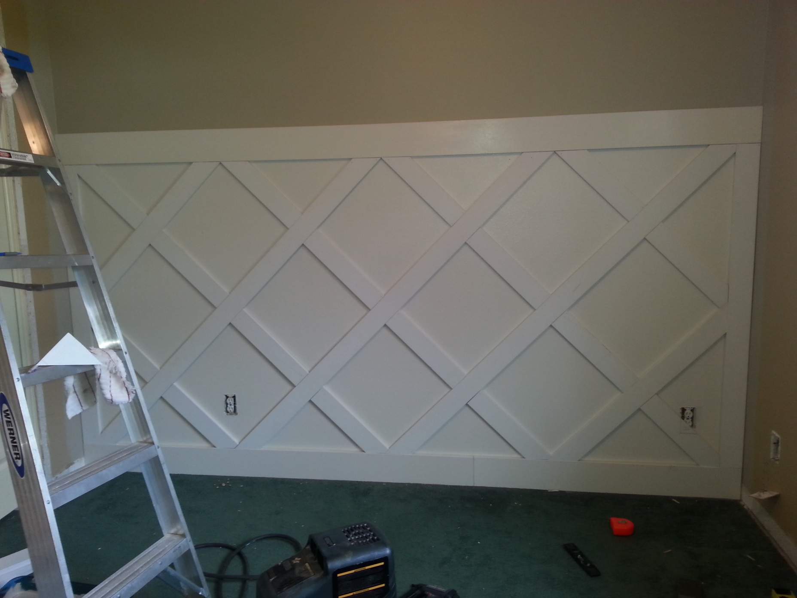
This is what the baby’s room looked like after Callie and I put up the trim.

Slide 4
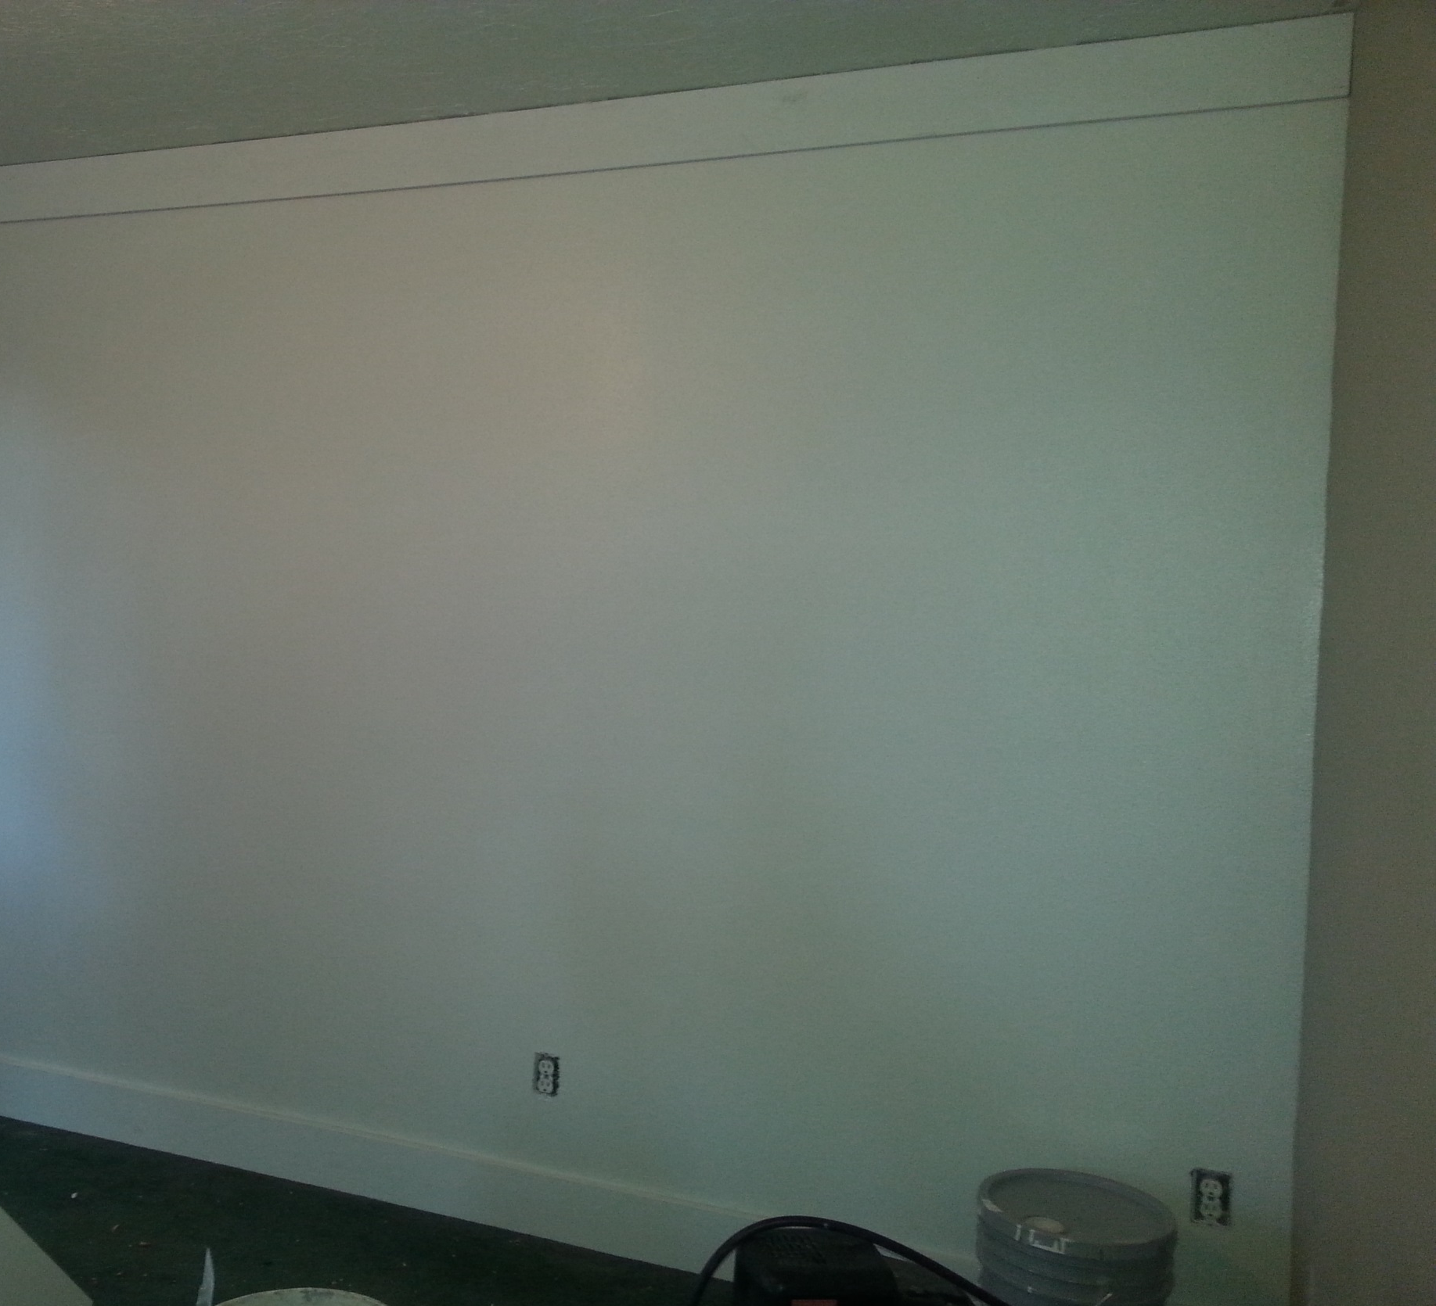
When we finished the baby’s room they decided to do a simpler pattern of trim for their bedroom. We started out like this.

Slide 5
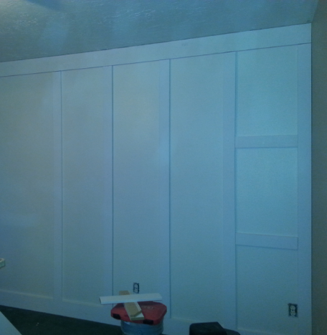
Then we added vertical boards, and inserted horizontal cross pieces.
It seemed simple enough…

Slide 6
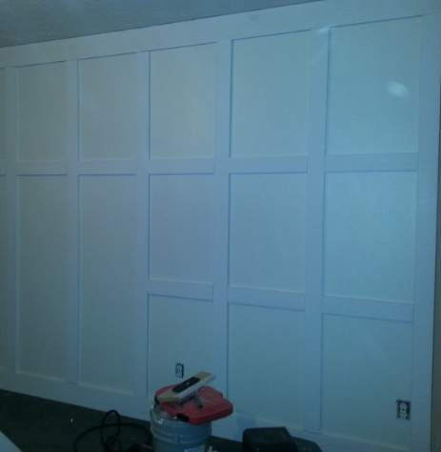
…until late in the evening, when the lumber stores were closed and we ran out of boards!

Slide 7
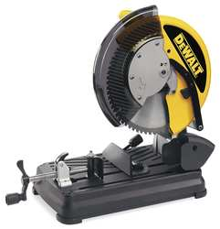
Where did we go wrong?

Slide 8
Your Discovery TAsk
How many boards should we have bought so we would not run out and also have the least amount of waste?
How many boards to buy…

Slide 9
11 feet 11 inches
The wall is 11 feet
11 inches long and
8 feet
tall.
8 feet

Slide 10
11 feet 11 inches
2 boards go the length of the wall on top and bottom.
8 feet

Slide 11
11 feet 11 inches
Vertical boards go the in between the top and bottom that create 5 columns.
8 feet

Slide 12
11 feet 11 inches
2 horizontal slats go in each column.
8 feet

Slide 13
11 feet 11 inches
The boards are 3 inches wide and come in lengths of
6 yards.
8 feet

Slide 14
Your Discovery Task
How many feet of board do we need? (round to the nearest foot)
How many yards of board do we need?
How many boards do we need to buy?
Explain your reasoning in words and diagrams.
Buying Boards

