Slide 1
BOLD Beginnings
6+1 Writing Trait: Organization

Slide 2
Ever picked up a book, or a story, and after reading just a short time you’ve put it down?
It’s missing a
BOLD Beginning!
What are BOLD Beginnings?
How do you write a BOLD Beginning?
I’m so glad you asked!!!

Slide 3
BOLD Beginnings catch the reader’s attention:
hooks your reader into wanting to read more.

Slide 4
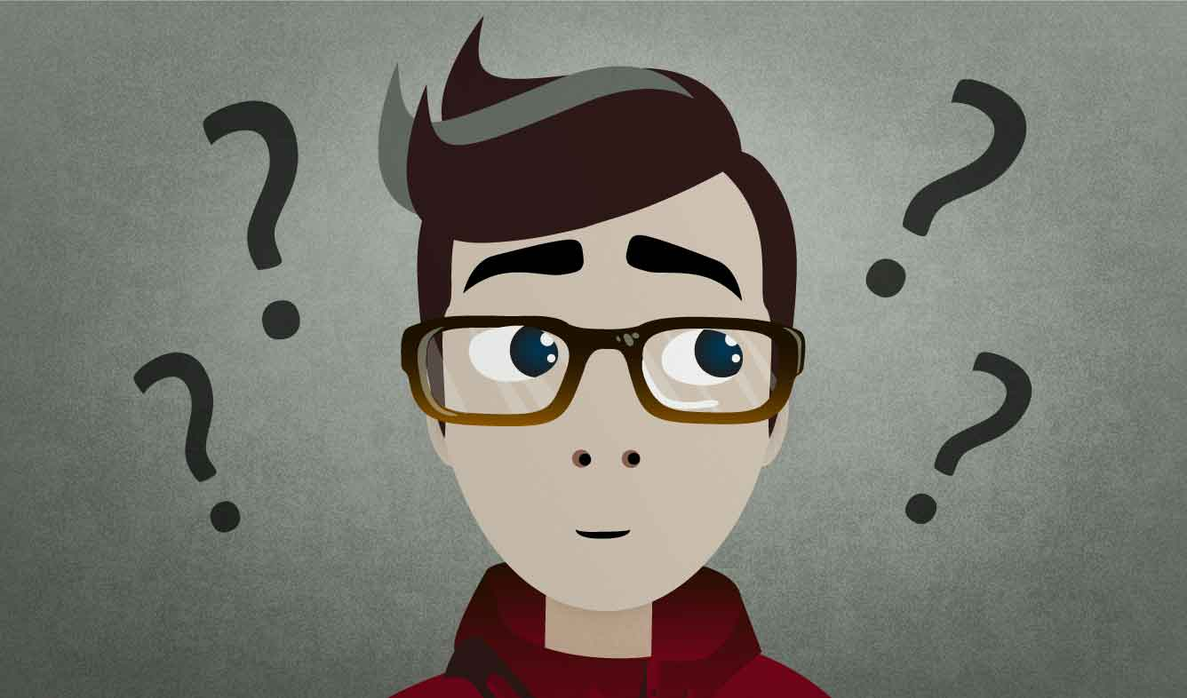
BOLD Beginnings make the reader want to read more:
What’s next?

Slide 5
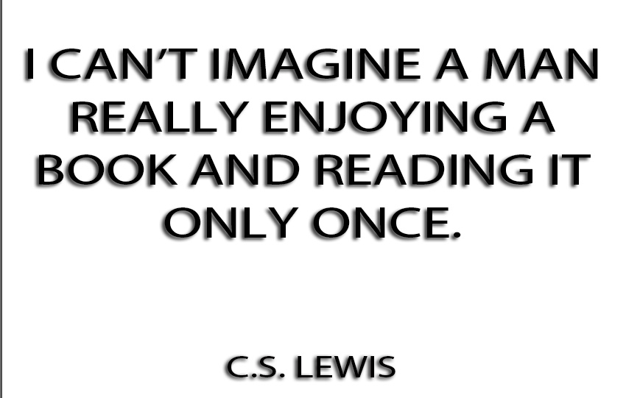
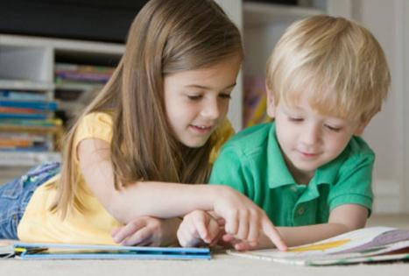
BOLD Beginnings make your reader feel your piece is going to be an interesting and enjoyable experience and worth their time

Slide 6
Thumbs Up or Thumbs Down?
Camilla wanted to fit in. She decides to not eat lima beans so people won’t laugh at her.
Camilla Cream loved lima beans, but she never ate them. All of her friends hated lima beans, and she wanted to fit in.

Slide 7
Thumbs Up or Thumbs Down?
I went to sleep with gum in my mouth and now there’s gum in my hair and when I got out of bed this morning I tripped on the skateboard and by mistake I dropped my sweater in the sink while the water was running and I could tell it was going to be a terrible, horrible, no good, very bad day.
It was a bad day.

Slide 8
Thumbs Up or Thumbs Down?
We went on a field trip to the farm and some things went wrong.
“How was your class trip to the farm?”
“Oh, …boring…kind of dull…until the cow started crying.”

Slide 9
Thumbs Up or Thumbs Down?
The news traveled swiftly through the tunnels of the ant world. A scout had returned with a remarkable discovery…
An ant came home with something in it’s mouth.

Slide 10
Now, read the beginning of your writing and give it a thumbs up or a thumbs down. Does it:
catch the reader’s attention:
make your reader want to read more?
sound interesting, enjoyable, and worth the reader’s time?
What’s next?
Alternate Activity

Slide 11
Alternate Activity HOOK FEST!
Using books in our room, each student is to find one book that “hooks” the reader using the first sentence or first paragraph.
In small groups, students will read the hook in their book to their group. The group will discuss HOW or WHY this was a great author’s hook.

